Slide 1
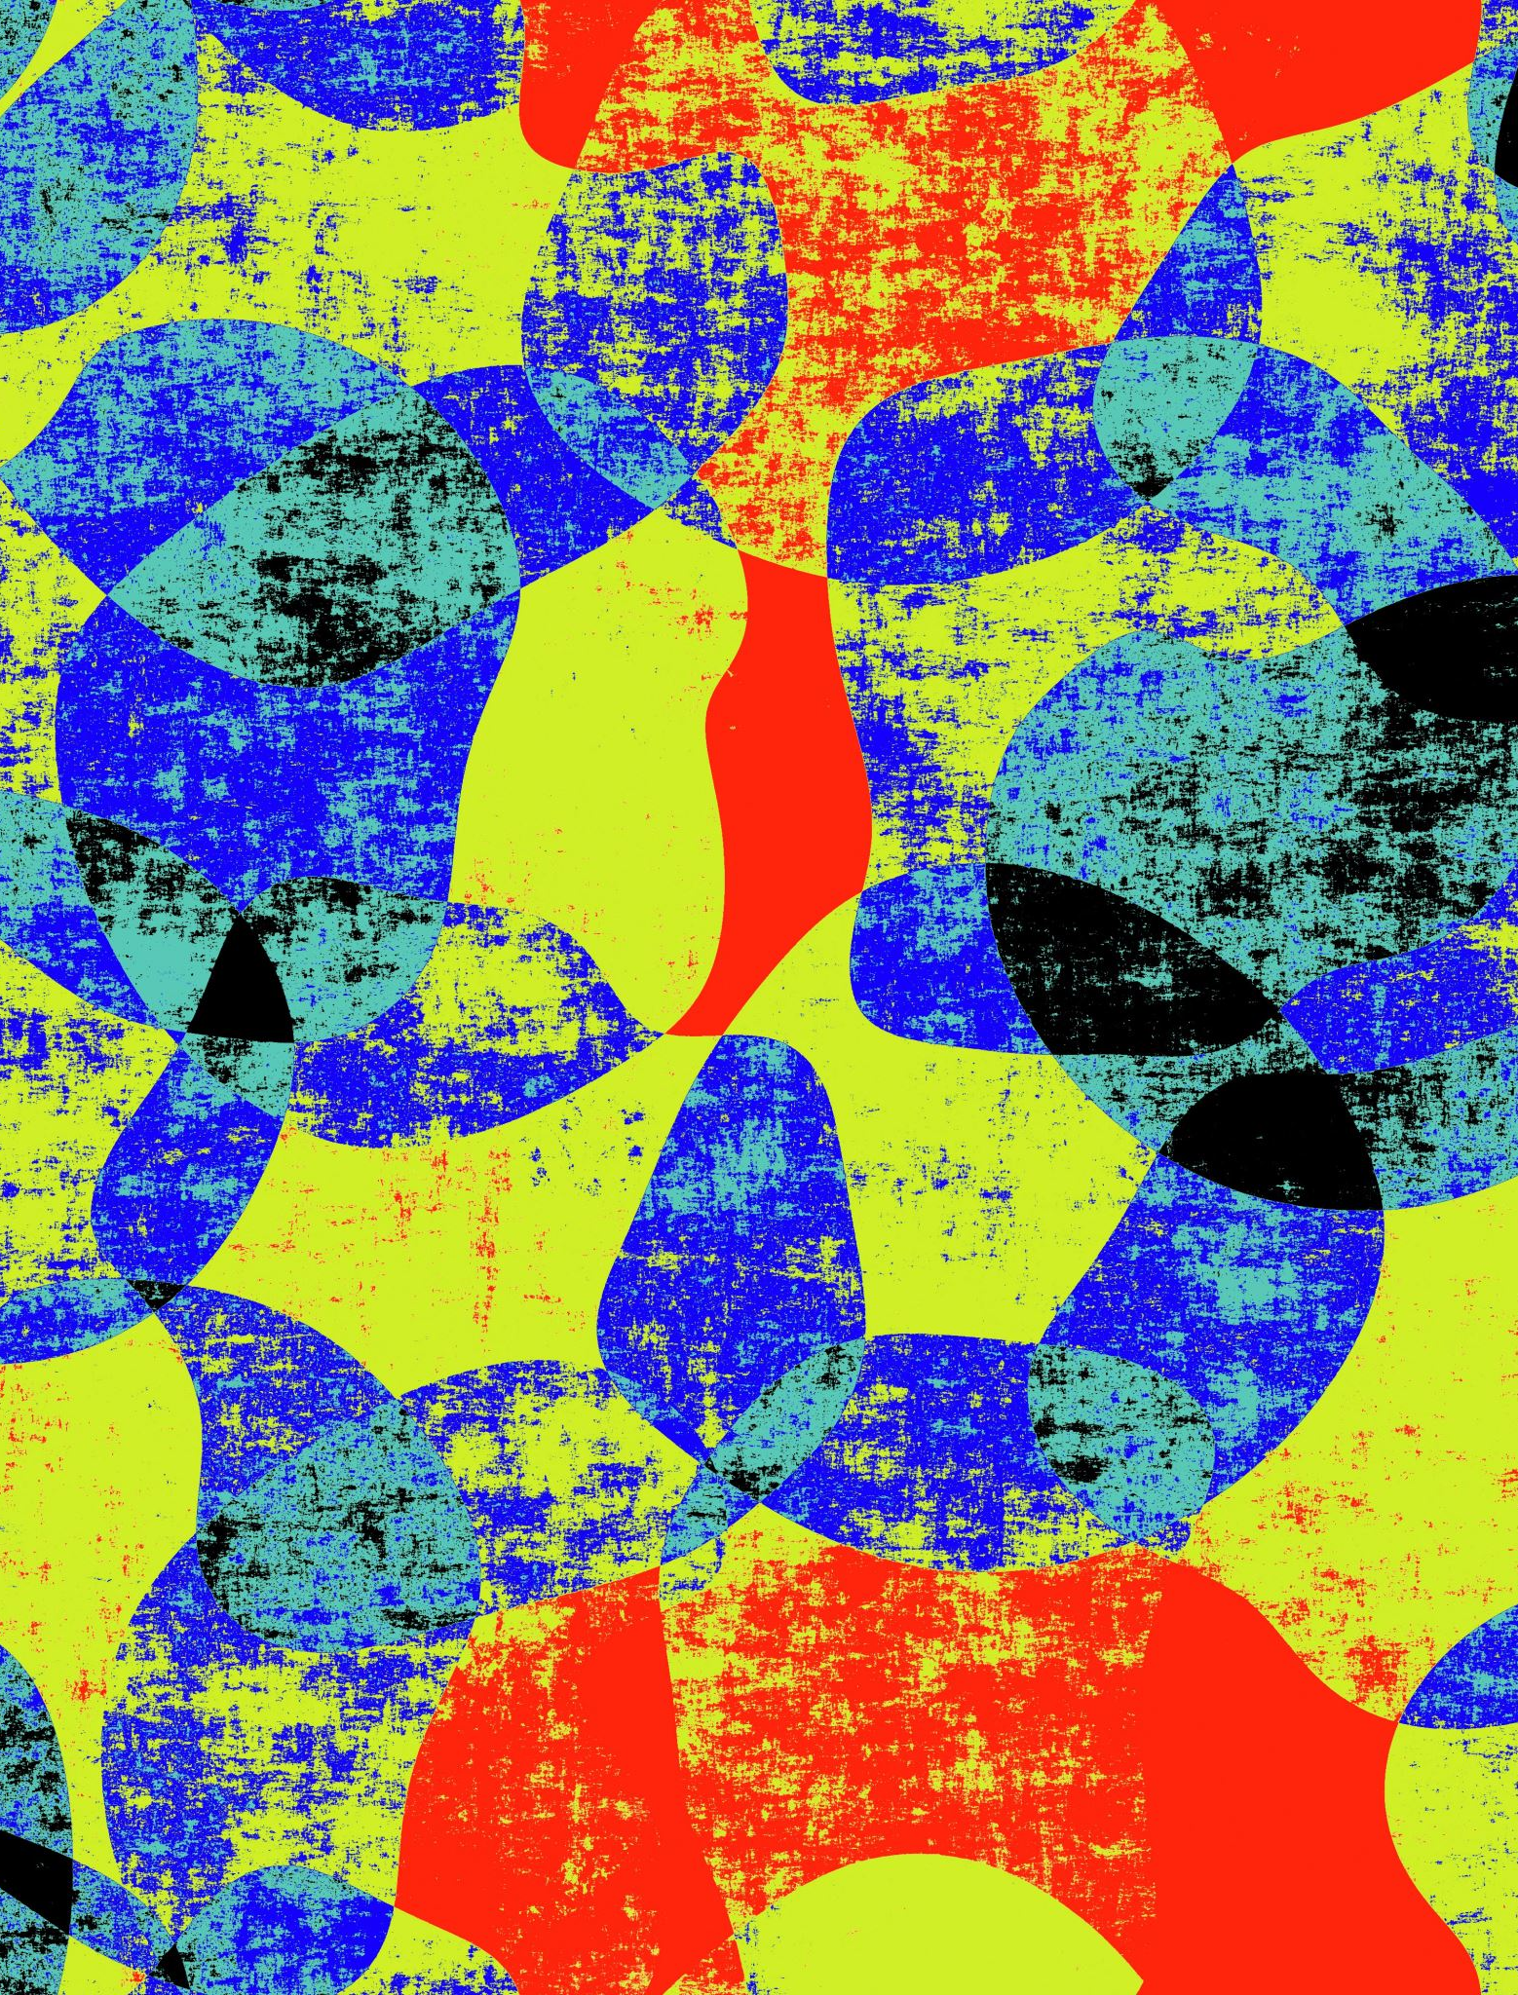
Forest Fire Risk Detection
Jimmy Lu
Jayce Zhang
Roger Ye

Slide 2
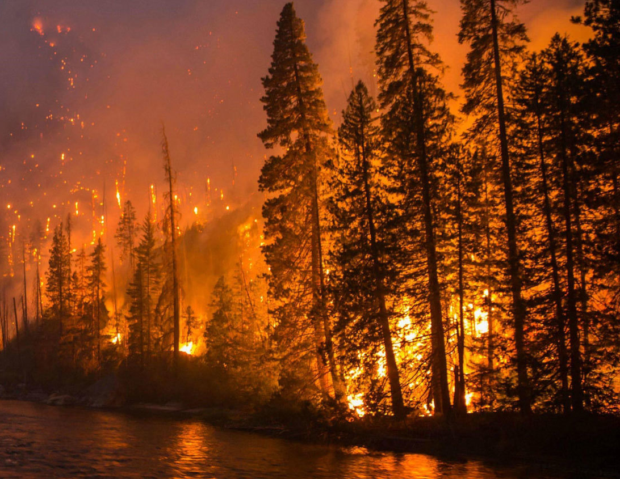
Why Forest Fire
With more than 1,600 fires burning nearly 8,700 square kilometers of land, the 2021 wildfire season in B.C. was the third worst on record in terms of area burned.
In total, $565 million has been spent on fighting wildfires this year, and 181 evacuation orders were issued.

Slide 3
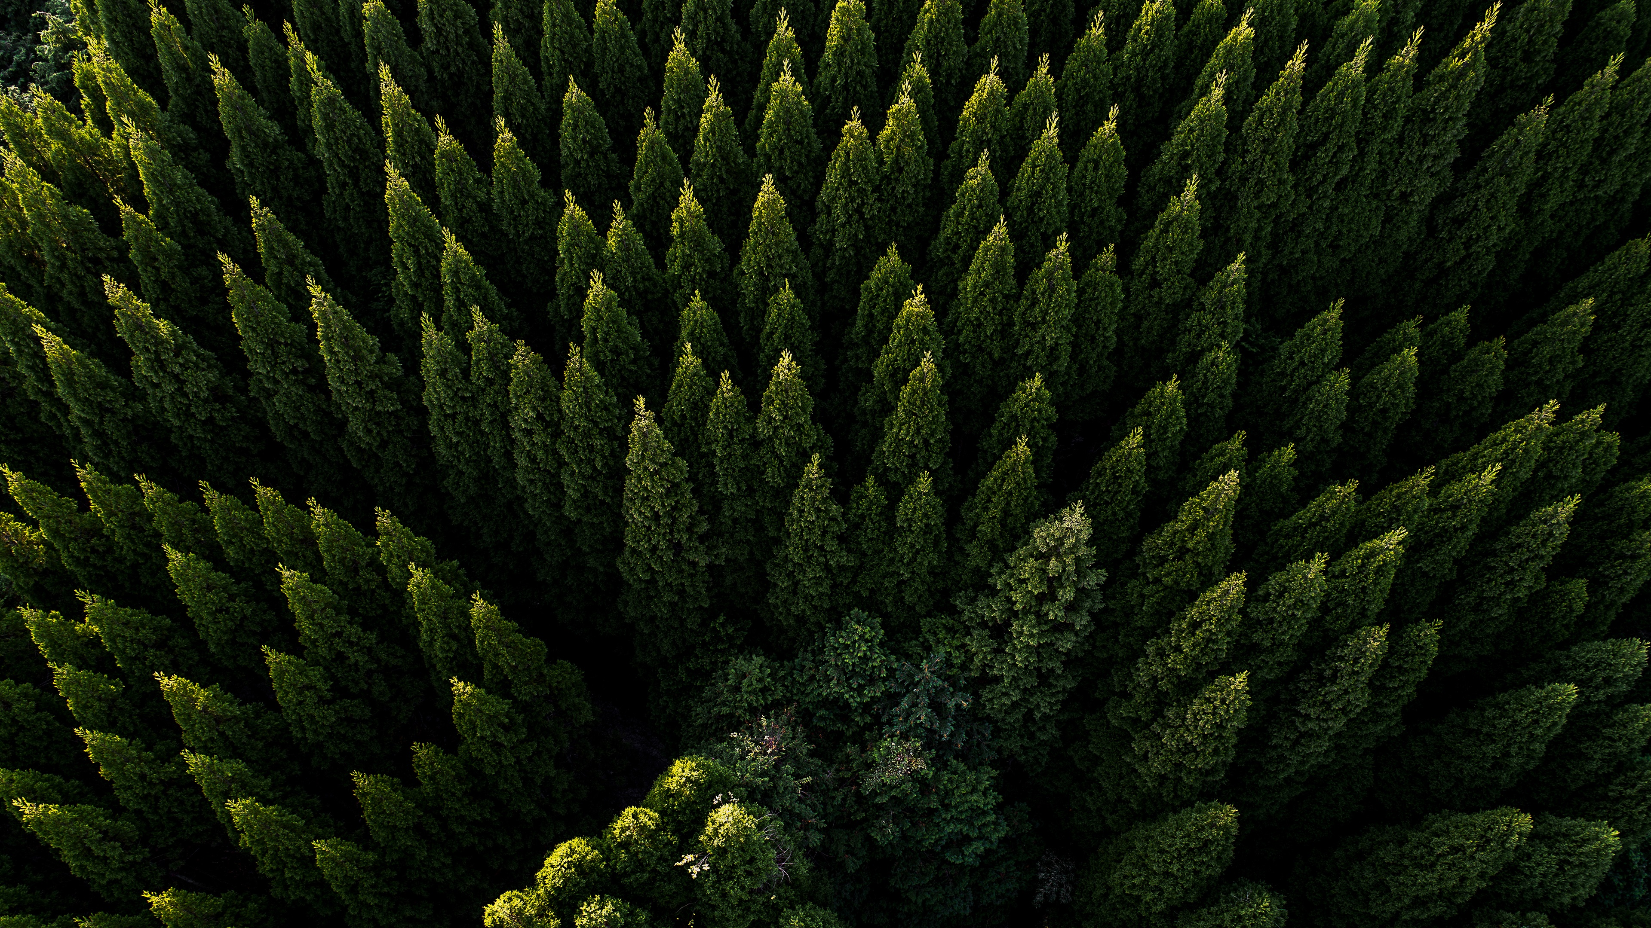
Project Goal
Using computer vision and machine learning to estimate the risk levels of the forest to help predict and prevent forest fire in British Columbia

Slide 4

Methodology and work flow

Slide 5
dataset
Annotated images: 589
Image size: 3,000 * 2,000
Total annotations: 43,521 (73.9 per image)
Data split: Training set (70%), Validation set (20%), Testing set (10%)

Slide 6
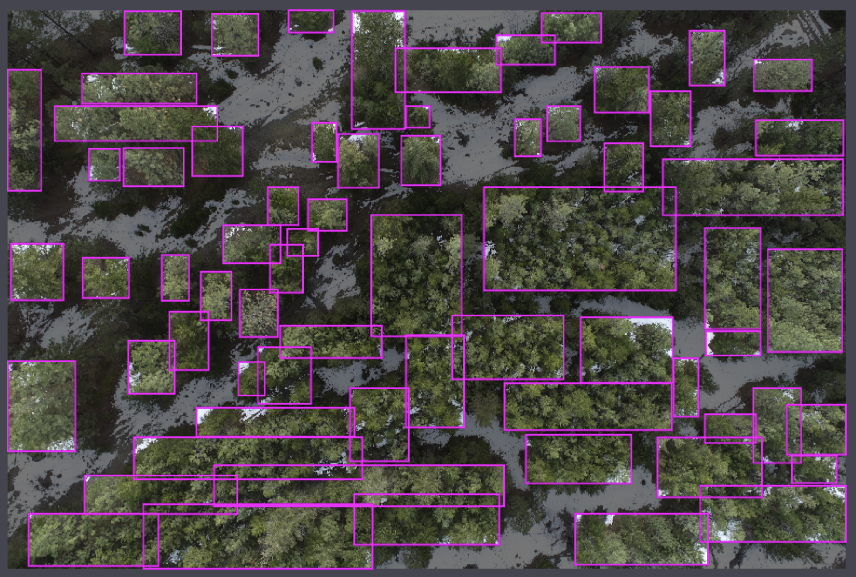
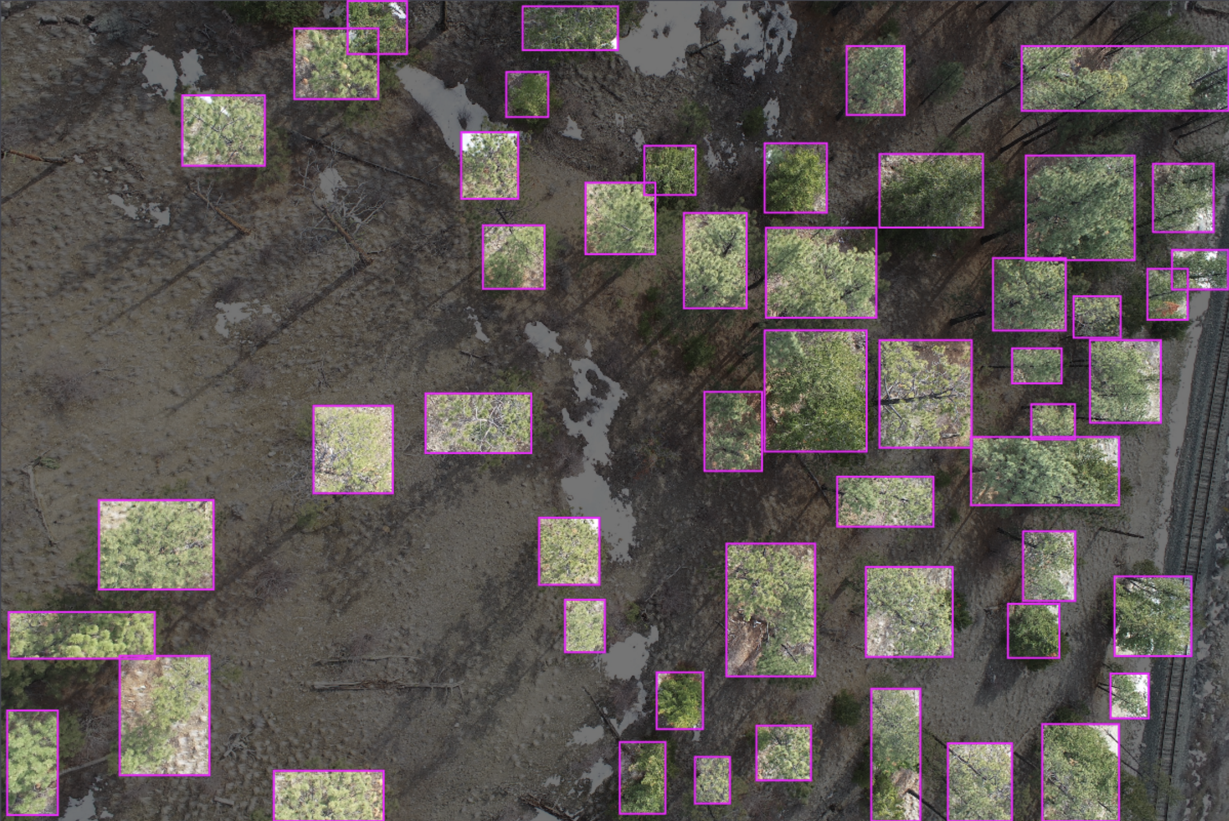
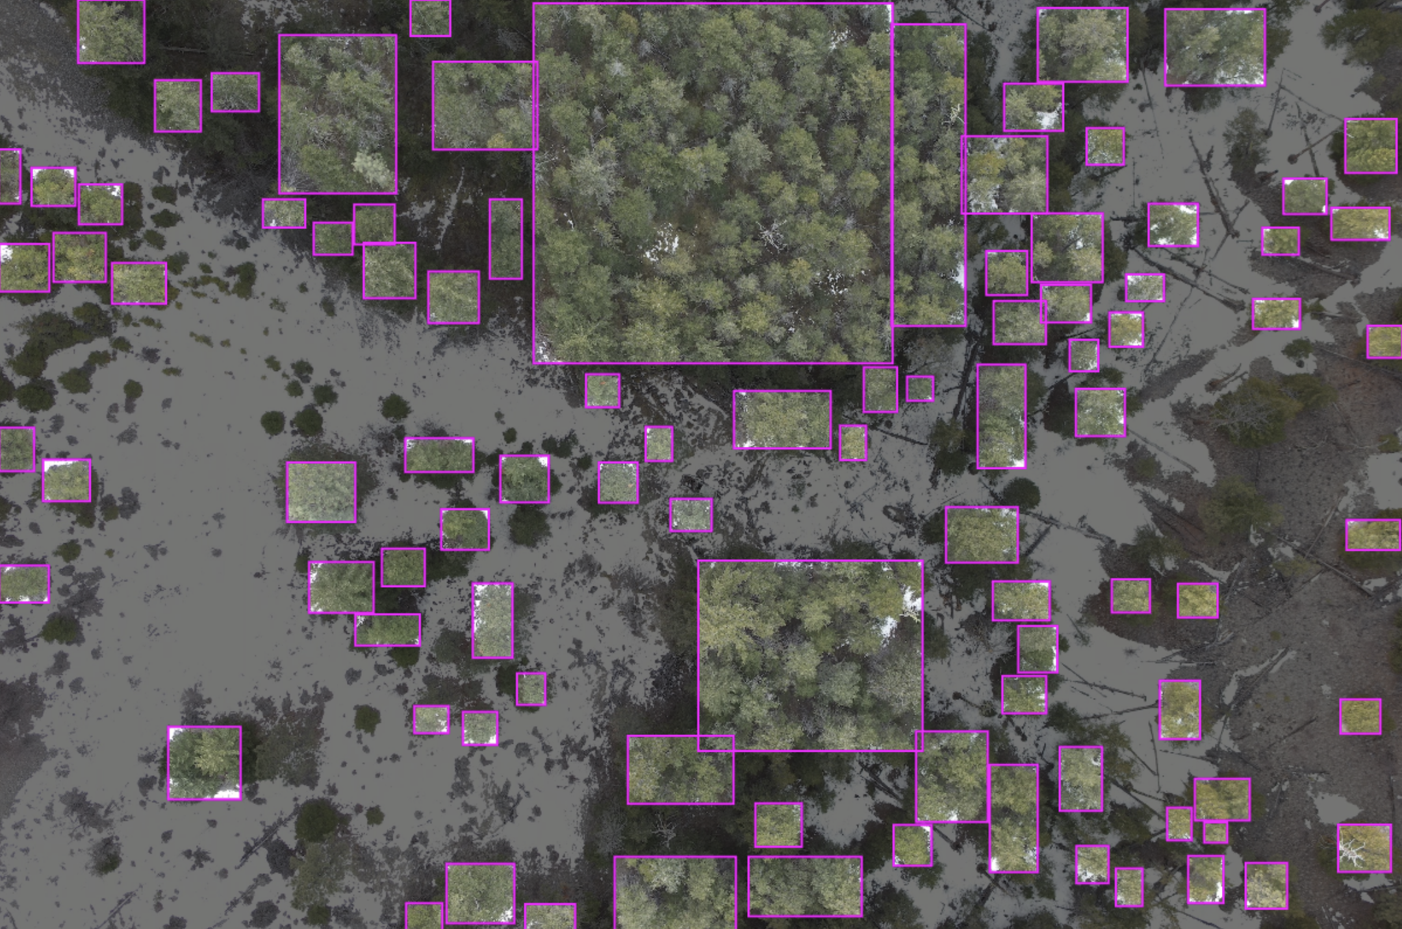
Annotations on Roboflow

Slide 7
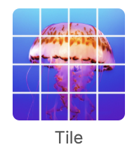
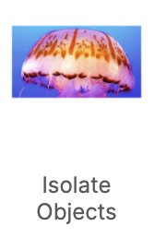
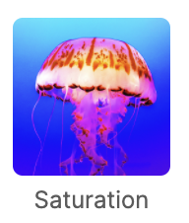
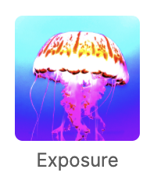
Pre-processing and augmentation
Pre-processing
Augmentation

Slide 8
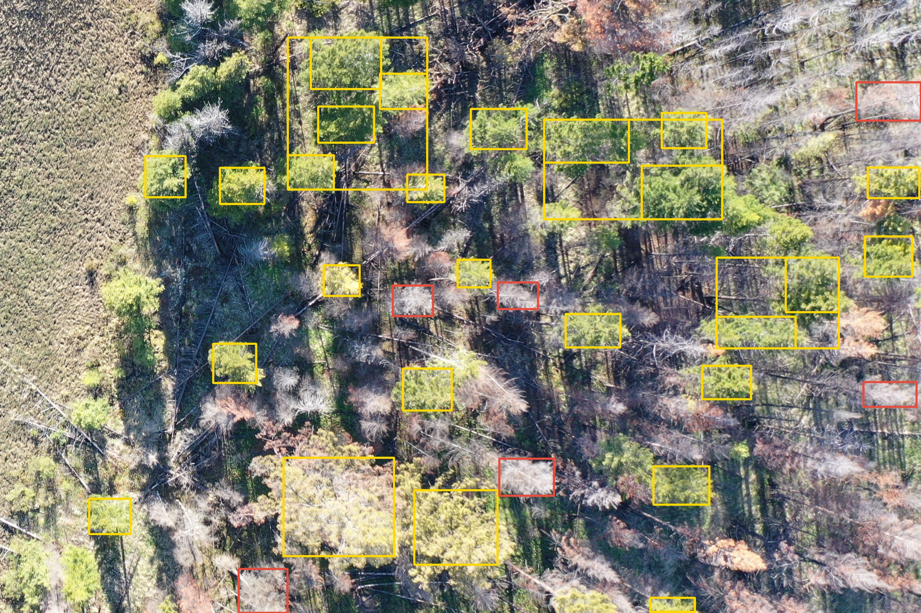
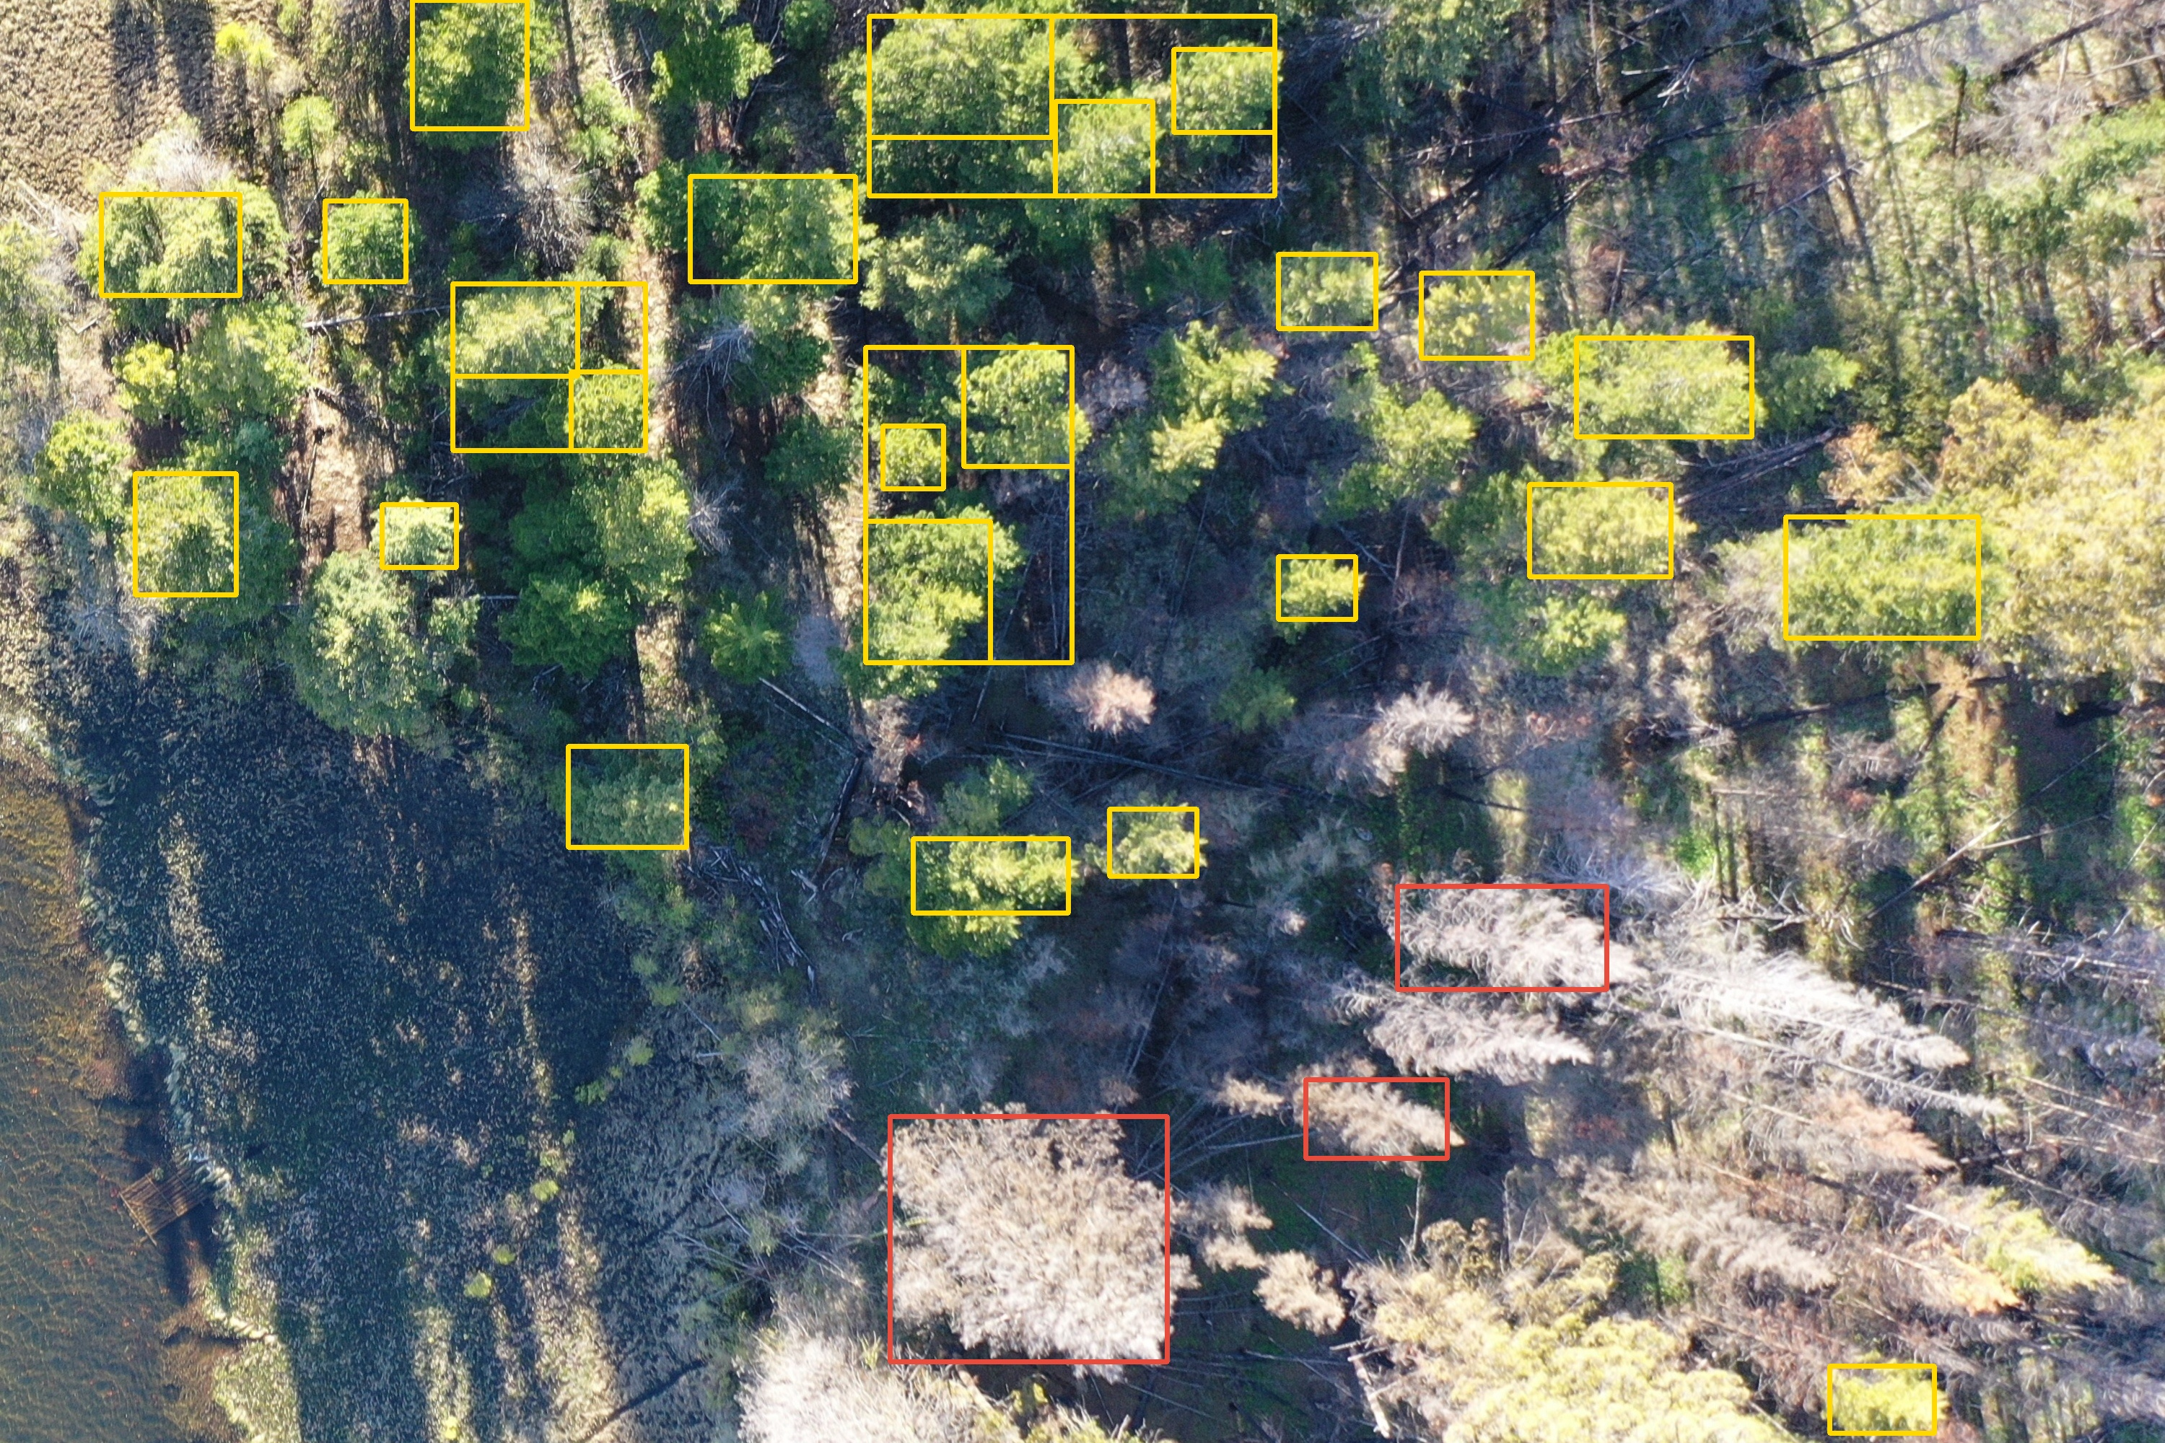
Train model using YOLOv5

Slide 9
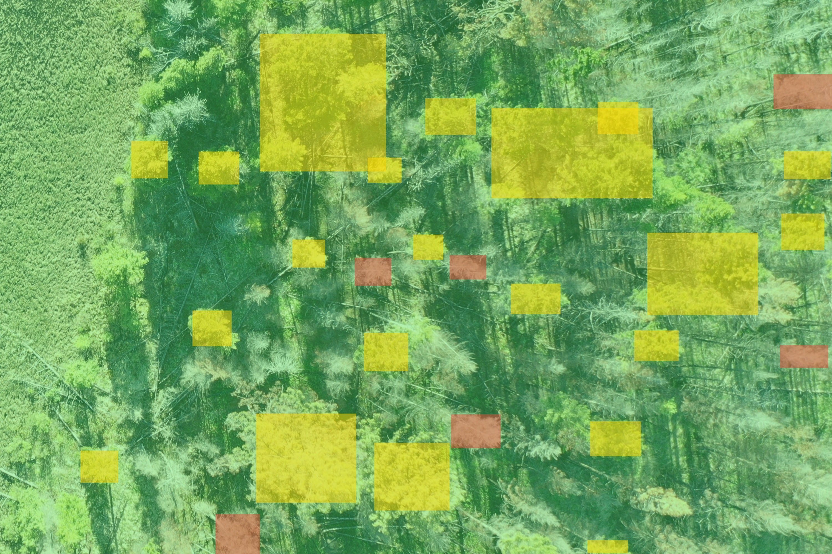
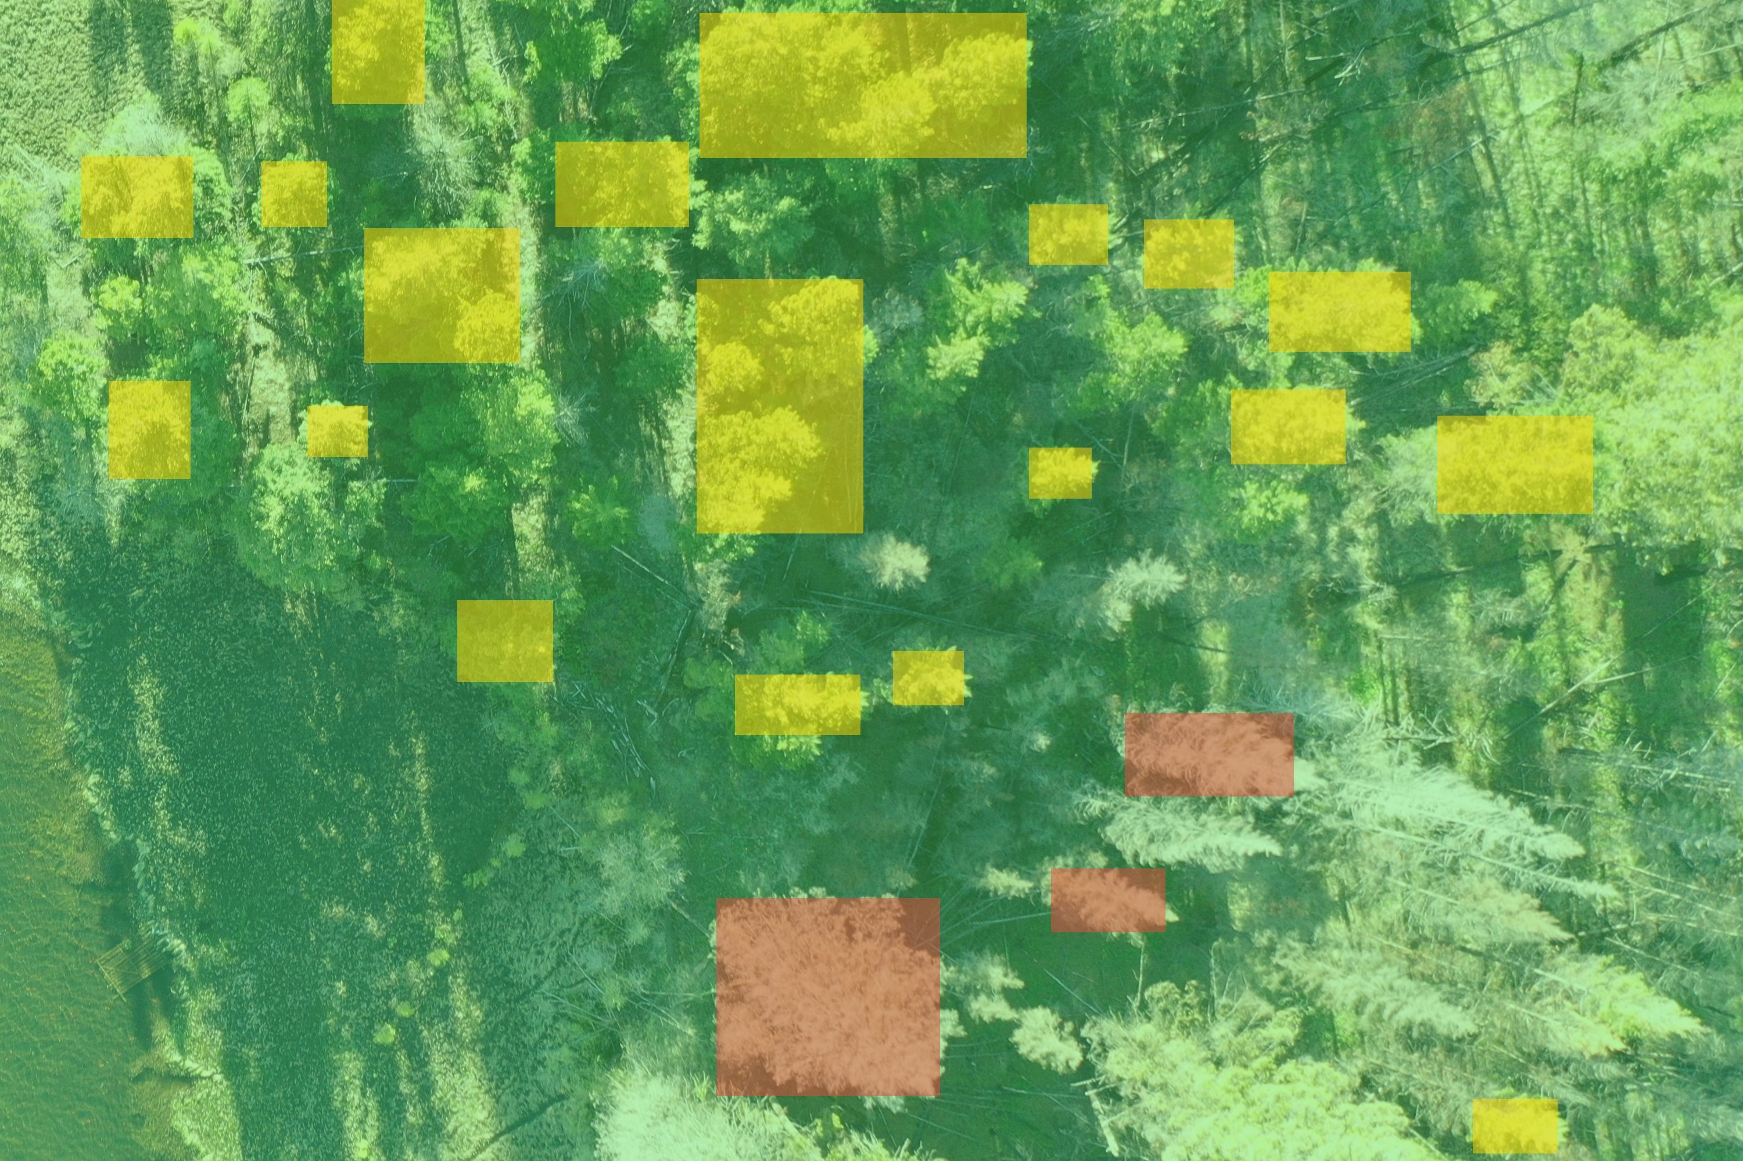
Map coloring (risk labeling)

Slide 10

Challenges
The raw images are hard to annotate the tree objects accurately.
We need to try different pre-processing and augmentation methods to find the best methods to improve the model performance and results.
We need to work out an algorithm to do map coloring to label different risk levels of the images.

Slide 11
Results and Rethink
Notes:
Now let’s talk about our results and rethink

Slide 12
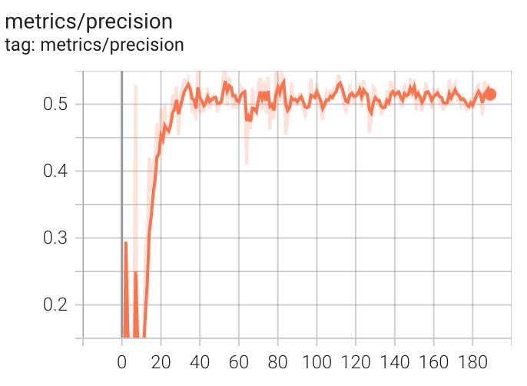
Comparison between different methods
 | Overall Precision | Precision of alive trees | Precision of dead trees
None | 56% | 61% | 51%
Tile with Saturation | 57.80% | 62% | 52.70%
Tile with Exposure | 55.10% | 60.30% | 50.10%
Only Exposure | 56.30% | 58.50% | 54.10%
Only Saturation | 57.30% | 62.20% | 52.40%
Isolate | 99.70% | 99.70% | 99.70%
Adaptive Equalization | 58.10% | 63.30% | 52.60%
Adaptive Equalization and Exposure | 54.30% | 59.50% | 49.20%
Notes:
In our project, we have only Five hundred eighty nine pictures, but we need to divide them into two labels and there are only a little different between tress and background. So, the amount of this dataset is too small to get the precise result, especially for the dead trees.
Roboflow gives us a very plenty options for augment and preprocessing, which mostly helped us to focus how to promote the precision through many methods not how to realize the different methods. We tried many ways, which include: tile, saturation, exposure, isolate, adaptive equalization. And we finally decided to use adaptive equalization, because of the best results. You could find all of these methods’ results in this form.
Firstly,
As we can see, there are three sections have the Exposure. But we found the original precision and precision of only Exposure is almost equal. Then we could compare this line with this line and this line, when we combined the Exposure with tile or adaptive equalization, we could even get the worse result. So, we could get the conclusion: Exposure is not suitable for our project. Because even we did not do that the edge of trees and background is not clear, when we randomly adjust the exposure it would aggravate.
Then,
In this form, we could find the isolation is abnormal. Isolation processing means using every annotation as a single image for training and testing, which excludes the background and thus achieves very high precision. but actually, when we apply our model to new images, we need to work on the whole image with the background, so the isolation method can be only used for training but not for detecting new images, and the precision rate will not be that high.
So we decided to use adaptive equalization, which we could also called adjust contrast in general.

Slide 13
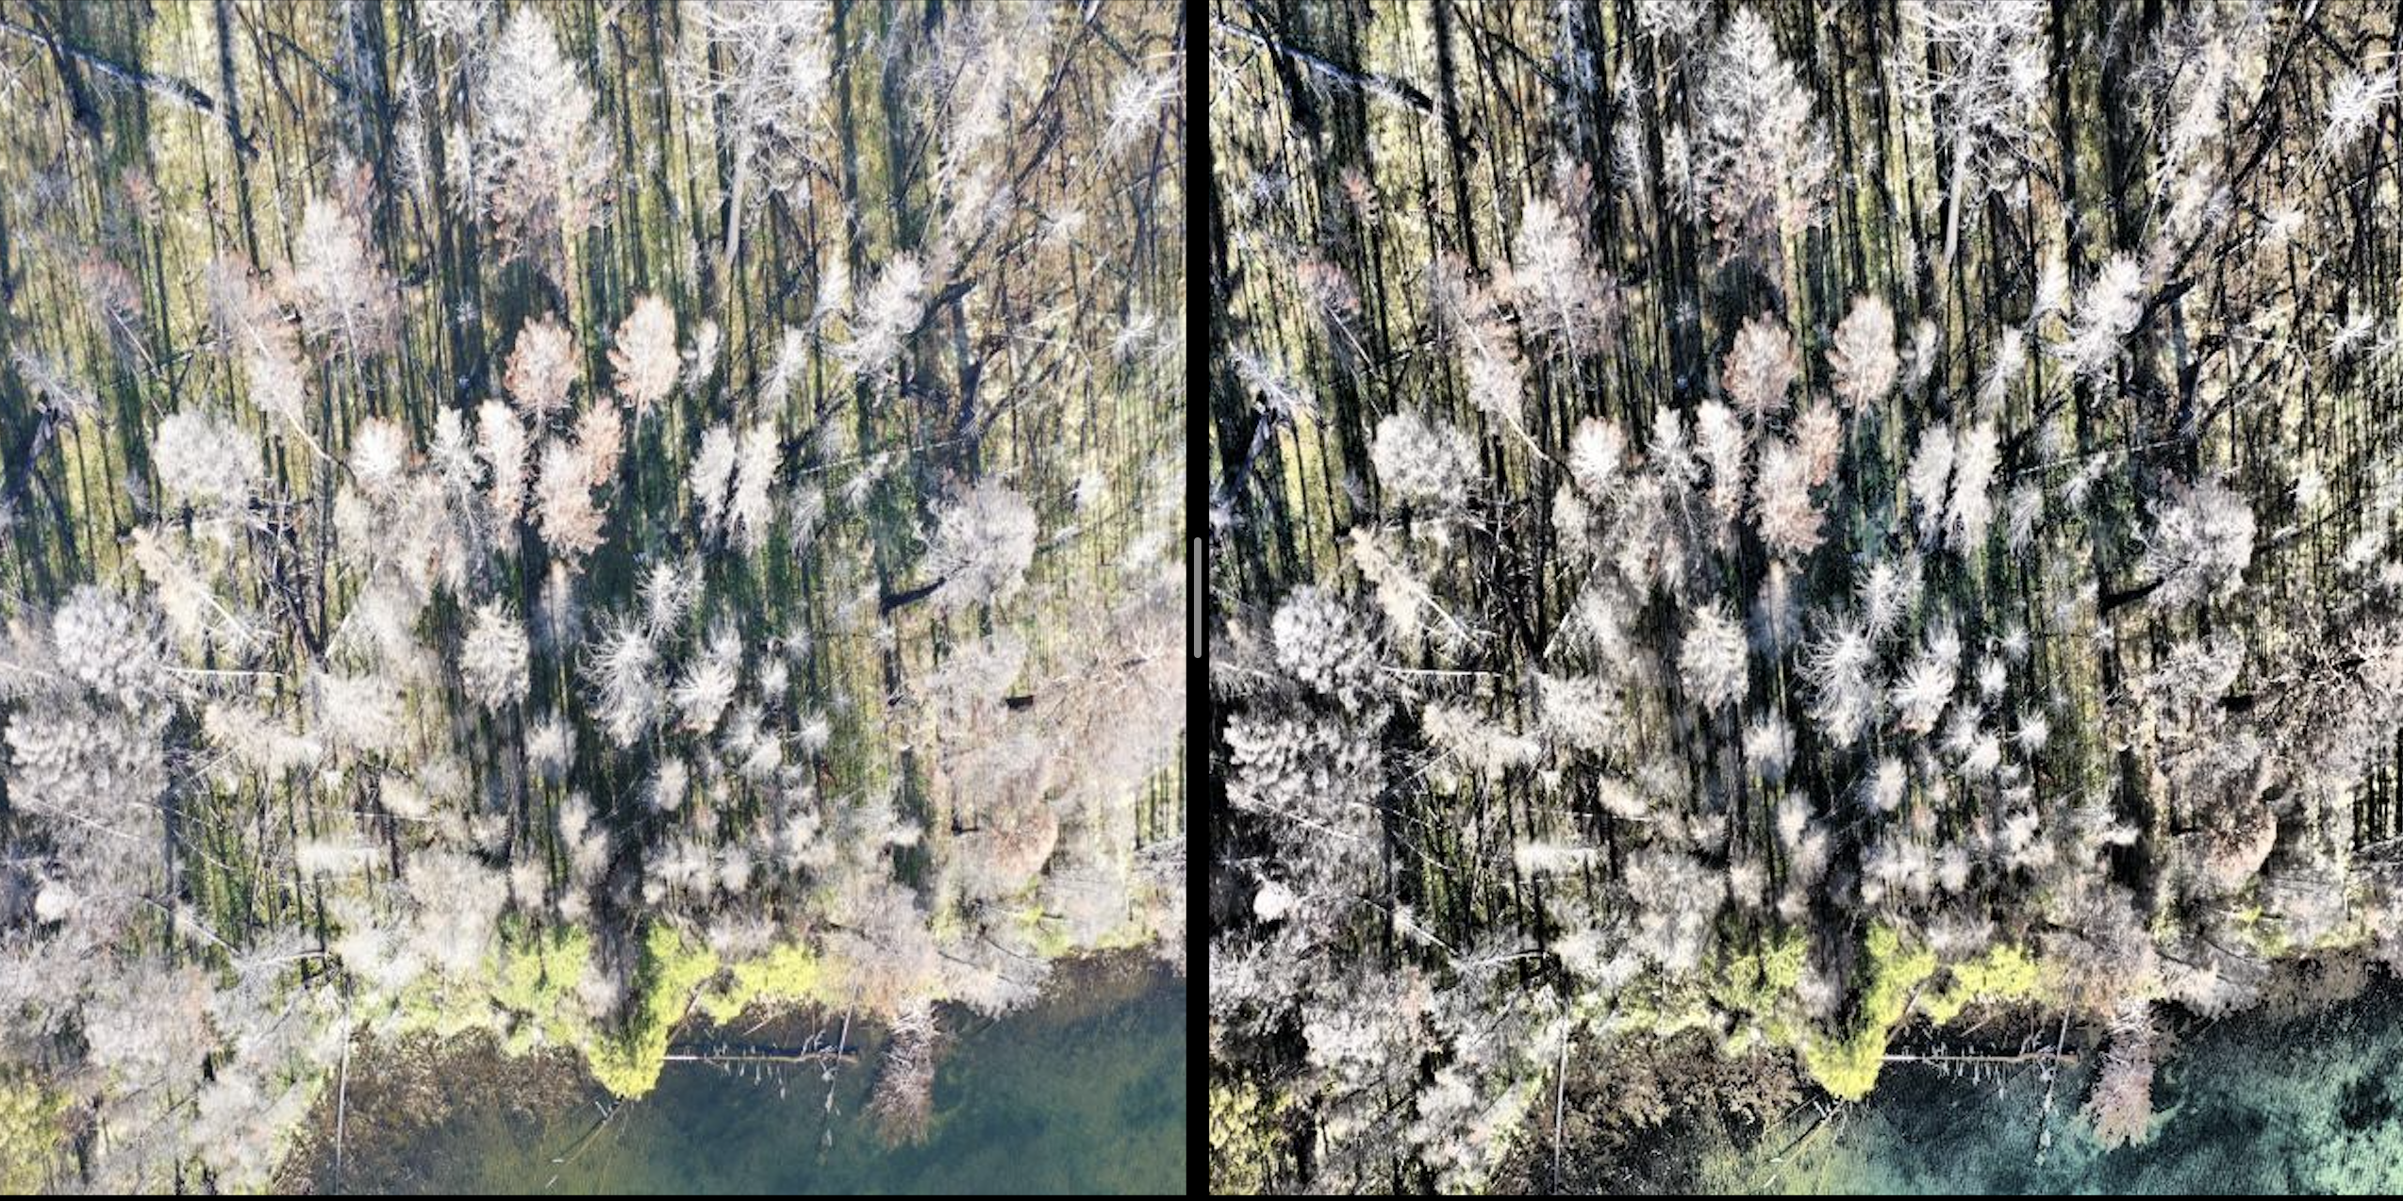
Original
adaptive equalization
Notes:
In comparing these pictures, we could see the effect when we use adaptive equalization the image on the right looks more clear, it would also be easier for YOLO to understand. When using adaptive equalization, edges become clearer as neighboring pixel differences are enlarged.

Slide 14
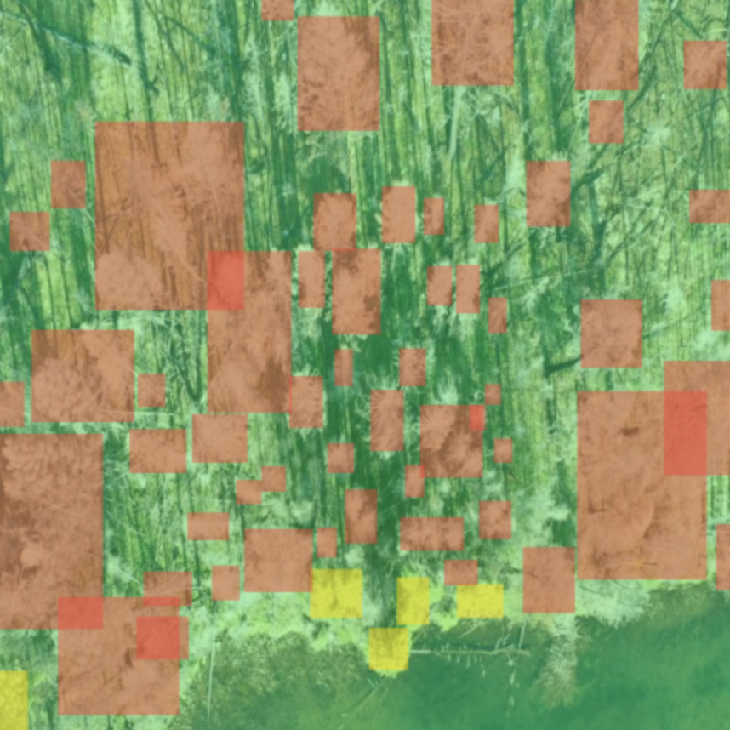
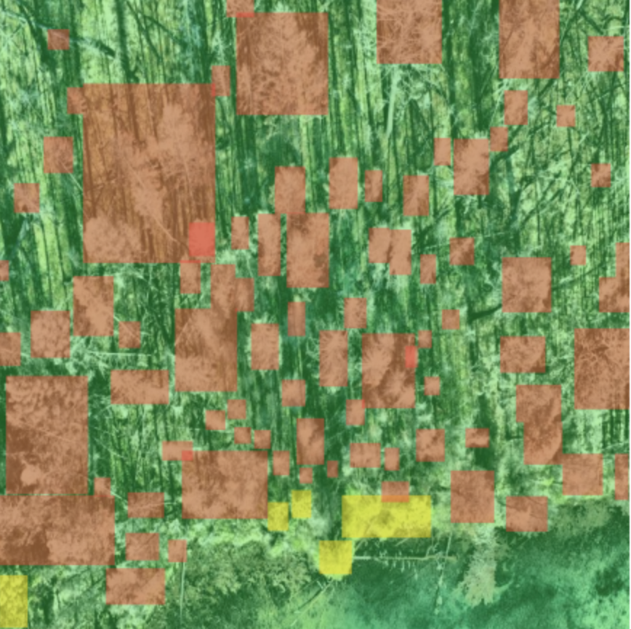
adaptive equalization
Notes:
Everything now seemed to go their way, the output from these two pictures are different. The right one obviously has the much more precise than the left one.
We could find many areas. Such as this this and this. The right one Could find more.
And we will show our demo how to output it later.

Slide 15
What did we learned?
That is a whole complete object detective project. We should do everything to solve this problem.
We learned how to use YOLO to detect different objects.
We learned many different augment and pre-progress methods. And for some cases, some augments could not help us get a better results, oppositely, it may pollute the dataset.
We tried many ways to promote the precision, such as different trained-weight from GitHub, many augment and pre-processing, but it could not get a obviously promotion. After deeply analyzing, we thought maybe there are two mainly reasons:
Notes:
Next I will show our rethink in these project.
Firstly, that is a whole complete object detective project, we should do everything from the original dataset processing train the model and use many methods to optimize it.
Secondly, We learned how to use YOLO to detect different objects.
Thirdly, We learned many different augment and pre-processing methods. And for some cases, some augments could not help us get a better results, oppositely, it may pollute the dataset.
The last is We tried many ways to promote the precision, such as different trained-weight from GitHub, many augment and pre-processing, but it could not get a obviously promotion. After deeply analyzing, we thought maybe there are two mainly reasons:

Slide 16
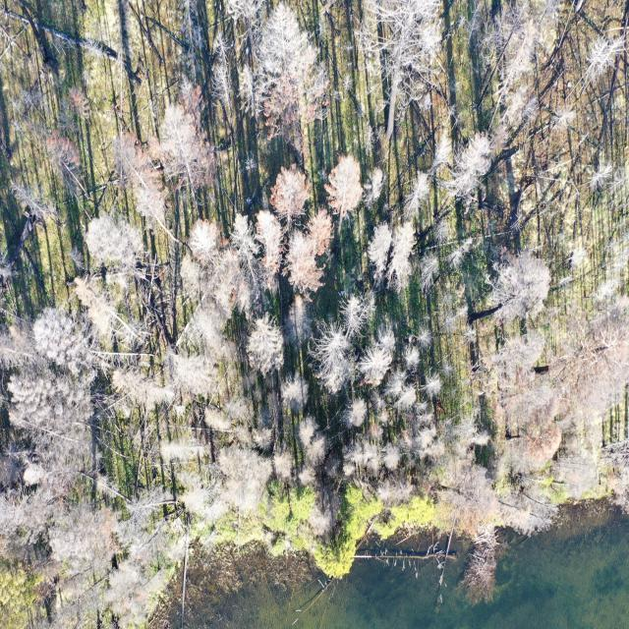
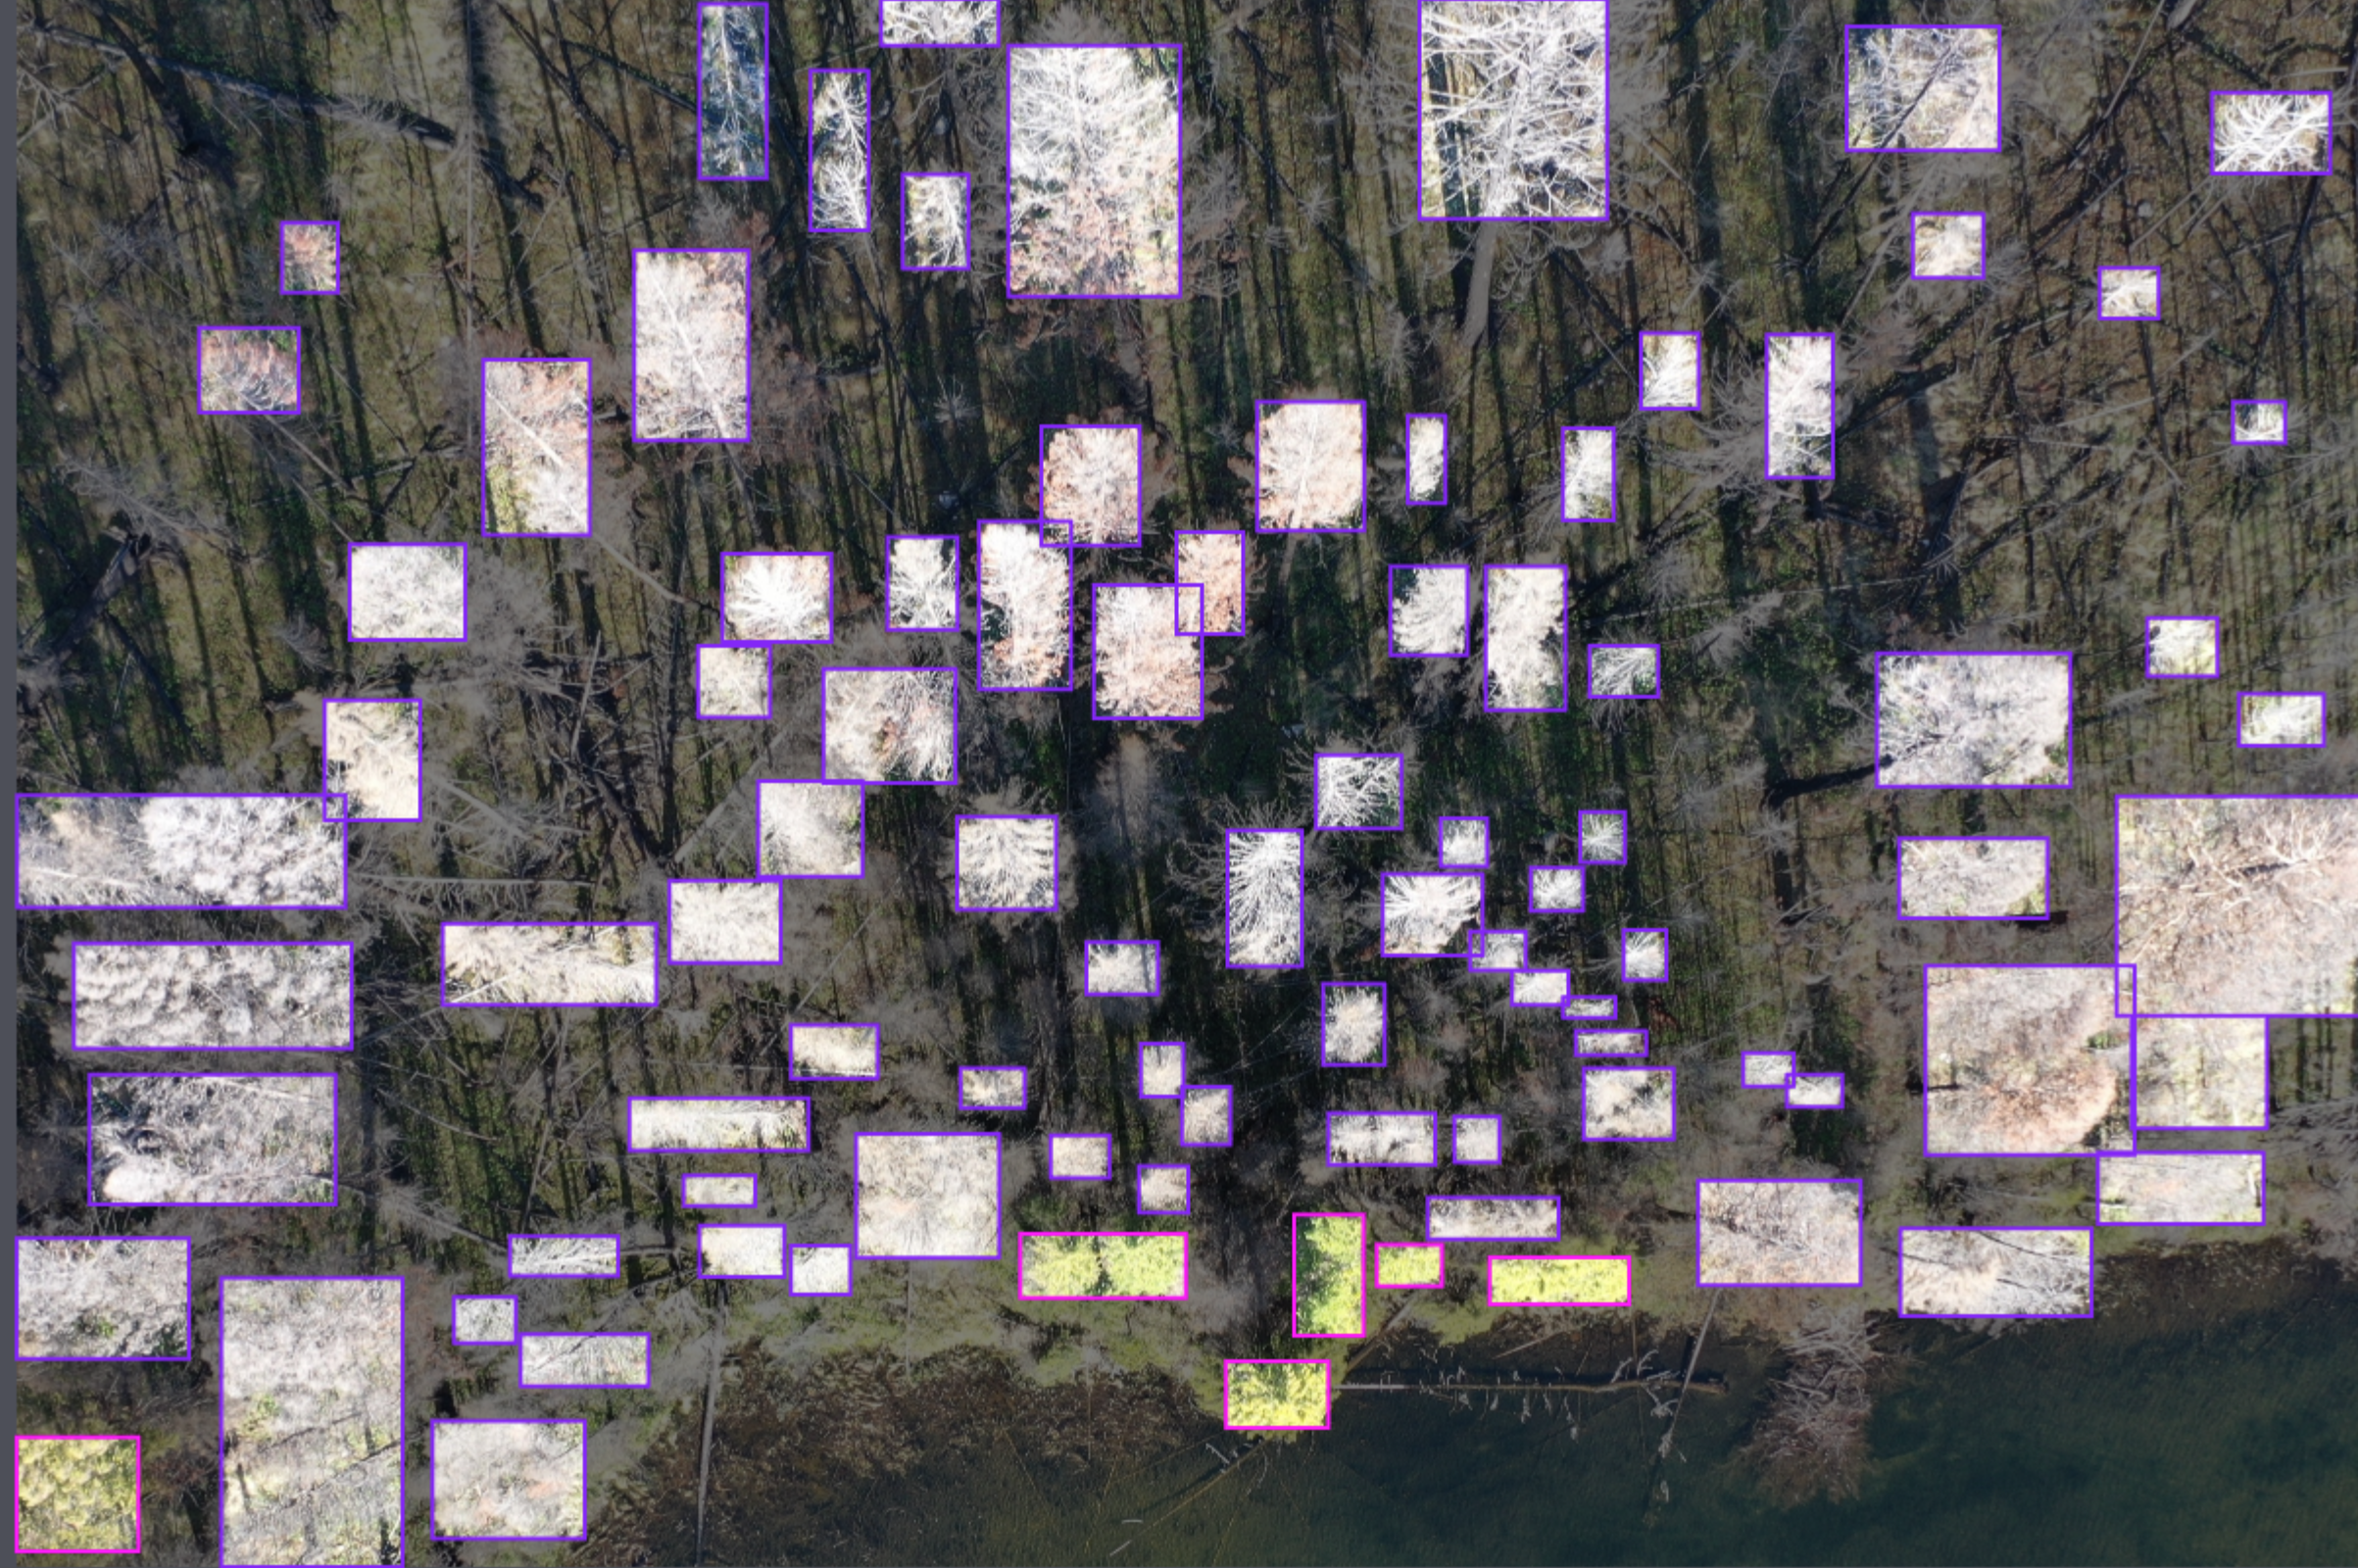
Firstly, the reason is our dataset is not precise enough. As you can see, we only label the most areas of these trees as much as we can, because we could not label all of the trees, that is different between facemask dataset and this.
Notes:
These pictures are very complex, we could not find all of them.
For example, you can see there and there, we could not divide it.

Slide 17
Detect by YOLO
Personal label
Notes:
But, the machine may find more tress than we did. You can see, there are many areas that we did not label, but the YOLO did. And there are also some areas we did but YOLO not. So, that is the first reason why we could not get a better result.

Slide 18
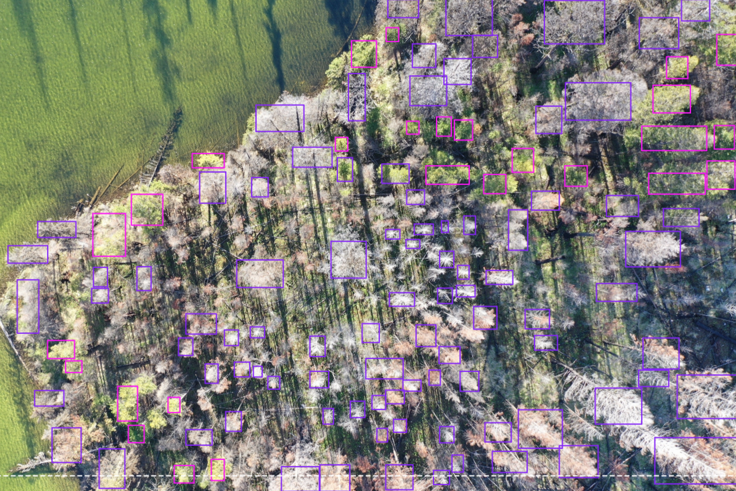
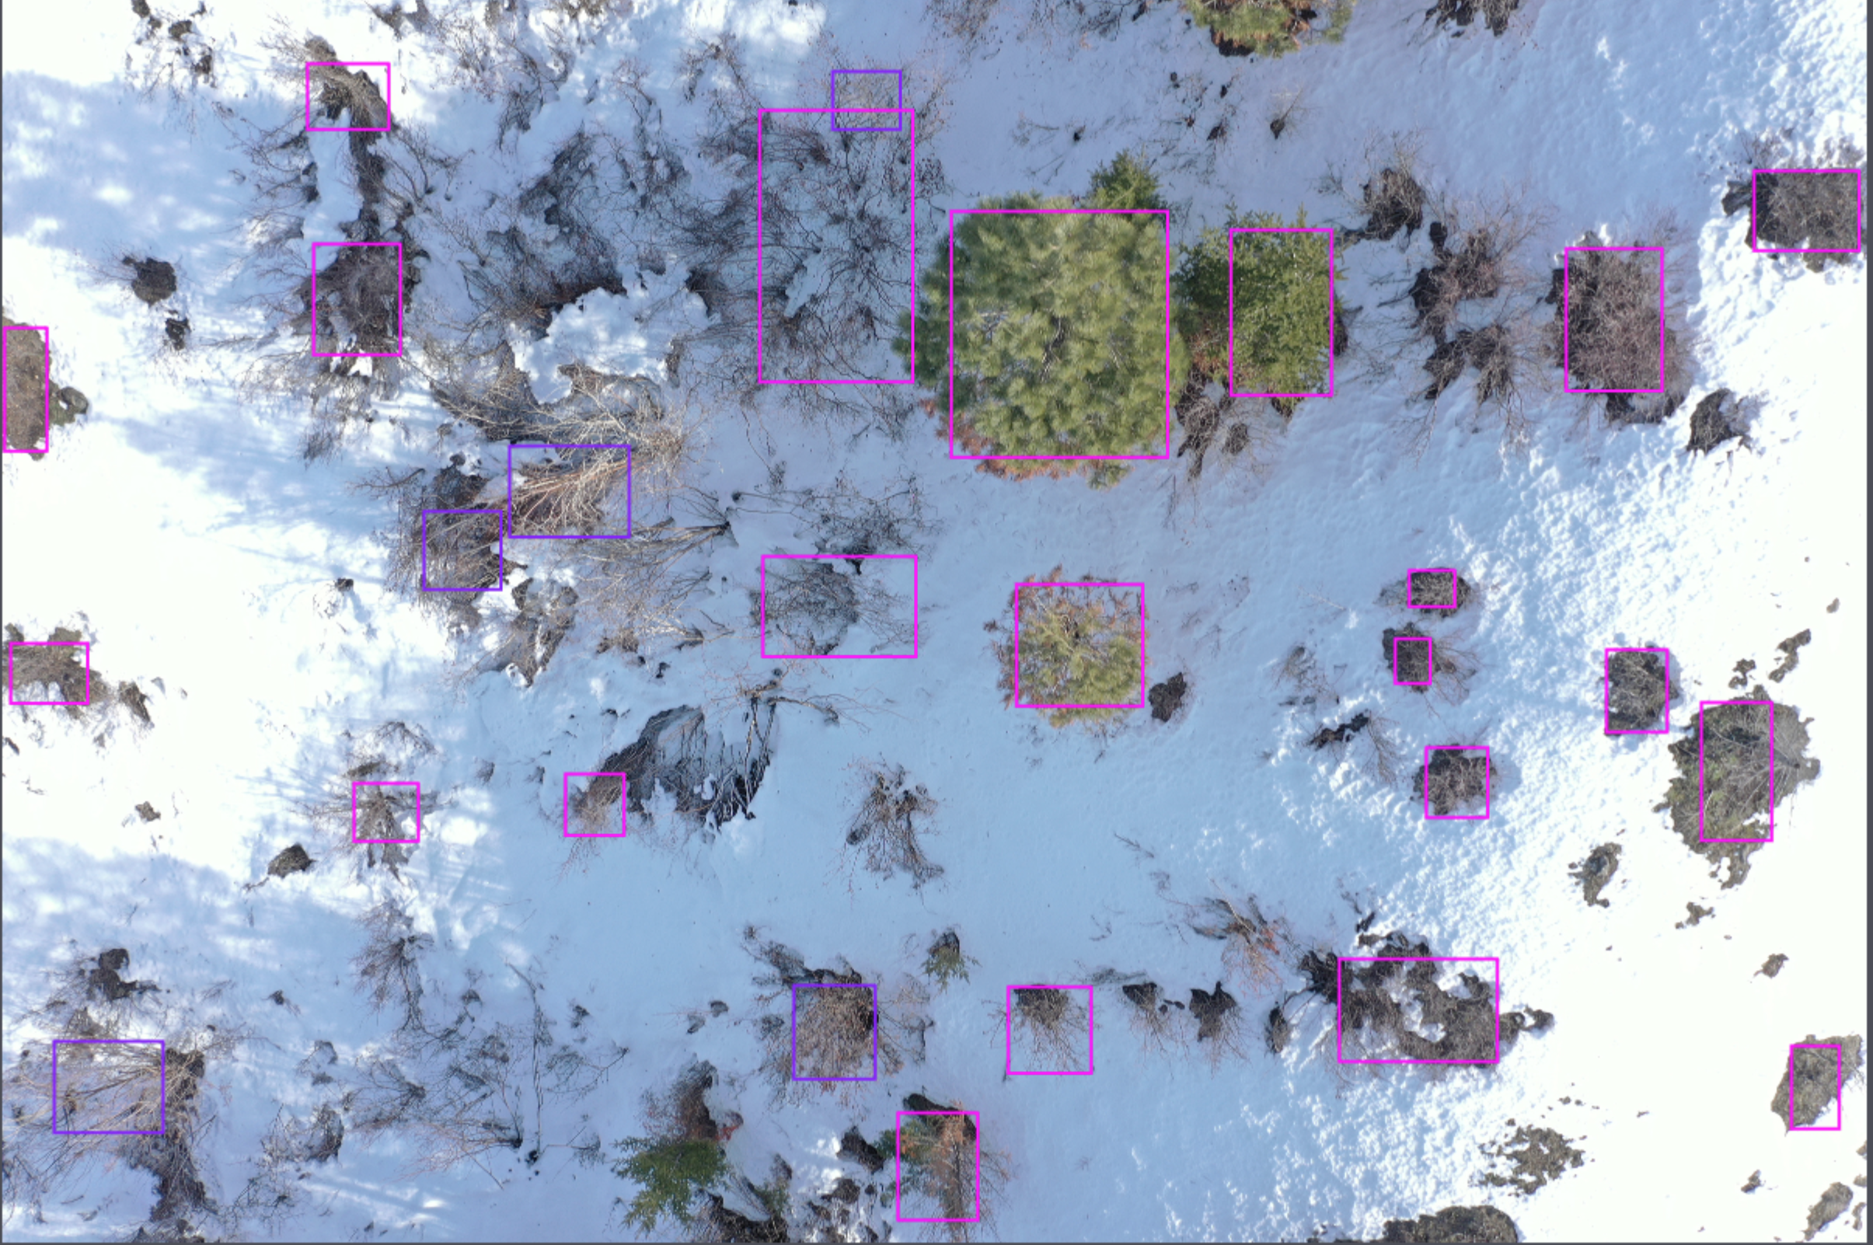
Secondly, we thought these trees were too similar to the background, especially for the dead trees. That was very hard to classify.
Notes:
In the left picture, the water and the ground have no obviously difference from the alive tress, there are all green.
And in the right picture, the dead trees were almost white that were too similar to the background,

Slide 19
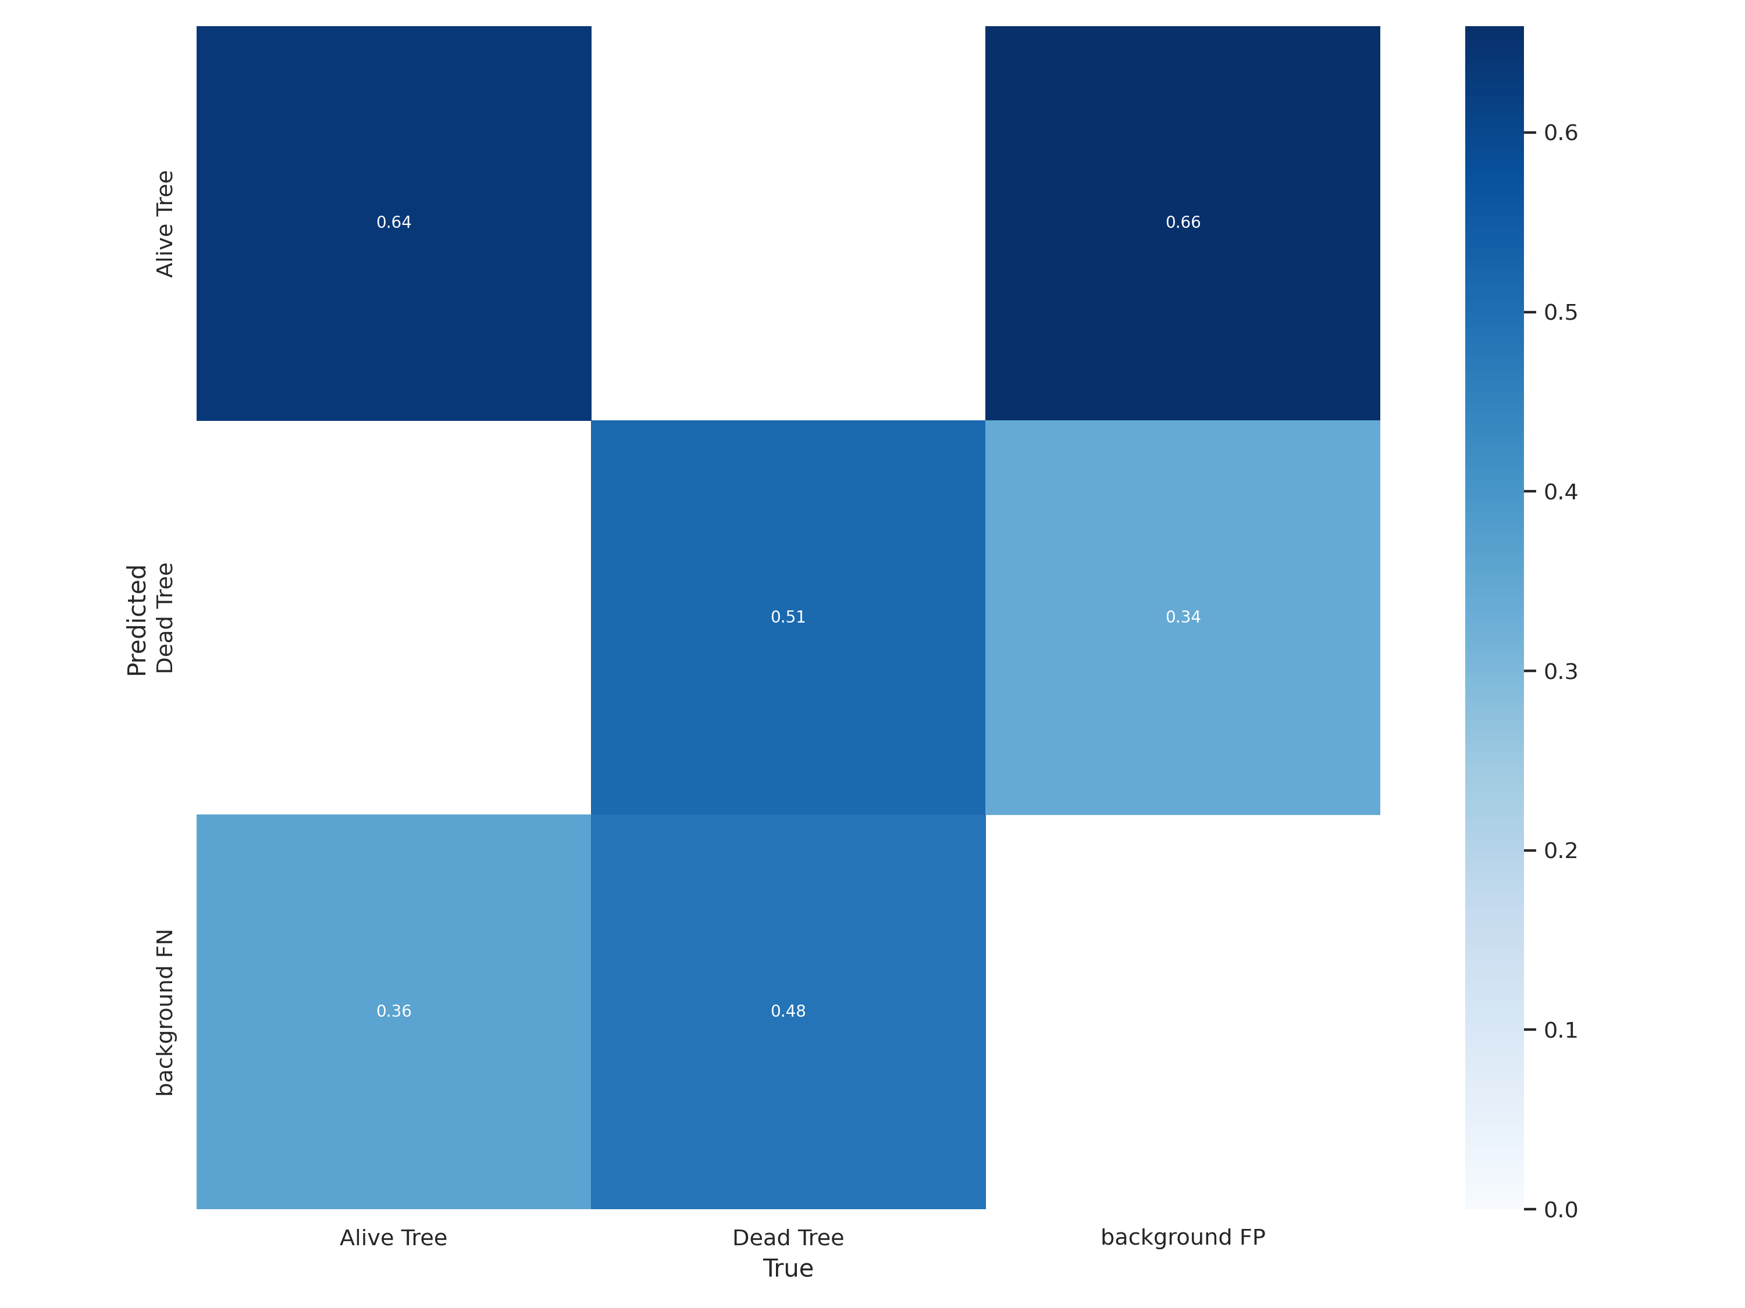
Confusion Matrix could tell us well.
Notes:
The confusion matrix could show us very clearly.
Although, that is a irregular confusion matrix, it could also show many deeply important information for us
Let’s look at this matrix.
X-axis is the true option that is noted by us, Y-axis is the output by YOLO. The first line means the precision of the areas which we noted as alive tree. Background FN means this area is not background, but YOLO regarded it as background wrongly.
We could find there are 36 percent which YOLO mistook this areas for background, which should belong to alive tree. And the mistake of background and dead trees reached up to almost 50 percent, that is very high.
Same as the third line, Background FP means this areas should be regarded as the background, but YOLO did wrongly. It has 66 percent to mistakenly believe as alive trees and has 34 percent regarded it as dead trees. But, the number of the alive tree is over six times than the dead tree. If we decrease the alive tree’s dataset as much as the dead tree, this percent could down to only 11 percent, that is one third of the percent of dead tree.
In a words, YOLO has the high probability to mistakenly regard the background as the dead tree, and may also mistakenly regard the dead tree as the background. Both of reasons I said could have an effect on this bad result at the meantime. But I also have a good news, that is we did the nice job at the classification between the alive tree and dead tree. In this module and this, are 0, that means we could classify the alive tree and dead tree one hundred percent.
Maybe this matrix is hard to understand, but these values told us some deeply information, which we can promote our work in the further.
That is all of our presentation, now let Jimmy show the demo.

Slide 20
Q&A

